Slide 1
Basic Select Queries and Stored Procedures
CMPE 2400
Databases

Slide 2
use Statement and go
The use statement specifies which database to access for the execution of a query script, or portion thereof.
  This may also be accomplished using the database dropdown box in SQL Server Management Studio
go causes the current group of statements to be executed immediately by the query processor, rather than grouping all queries into a single batch before execution
  Proper use of go in this course will include separating questions on labs / exams
  Ensuring that create statements always appear as the first command in a batch

Slide 3
Absolute Naming
Though use statements could be used to navigate between databases for the execution of individual query batches, and will even be necessary at times, a preferred method is to have your query batch work no matter what database you are in whenever possible.
  This is accomplished by resolving the table names in your queries to the databases in which they reside.
  Another benefit to absolute naming is that tables in more than one database may be accessed in a single query.

Slide 4
Absolute Naming
The syntax is fairly straight-forward.
DatabaseName.SchemaName.TableName[.ColumnName]
Note that for older databases, ones that predate the introduction of schemas, the SchemaName is always dbo, which stands for database owner.
  Both the NorthwindTraders and Publishers databases use dbo.
  dbo is still a valid SchemaName choice in newer databases.
Also note that the ColumnName is an optional add-on to the absolute naming syntax, but is not a requirement unless there is a ColumnName duplicated between the tables.

Slide 5
select
The purpose of the select command is to retrieve a result set.
  This does not mean that a table in the database must be accessed for data.
  Literal values may be selected, as well as calculations
    Literal values may be numerical or text based

Slide 6
select
The select statement is used to create a query that will return a set of data.
  When a table is specified, it will be the source used to retrieve said data.
select [field] from [table]
select [field1], [field2] from [table]

Slide 7
select *
The * operator can be used to return all of the fields in a table, and all of the data for each row in the table.
  This is basically a data dump.
  -- returns all fields from employees table
  select * from NorthwindTraders.dbo.Employees
  Avoid using * in a production RDBMS
    Causes a table lookup for actual field names every time it is used.
    If the structure of a table is changed, the order of the returned fields will also change, possibly causing queries to break.

Slide 8
Aliasing Using as
Often, a column name used in a table may not be meaningful if it is used to present data to the user
  “au_n” is only obvious to someone familiar with the database
The as keyword allows you to set an alias that can be used for a column name or table name in the query
The alias will be displayed as the column heading to the user
  Note that this does not change the column name in the database
In this course, we shall alias all columns that are not a single, easily understood word.

Slide 9
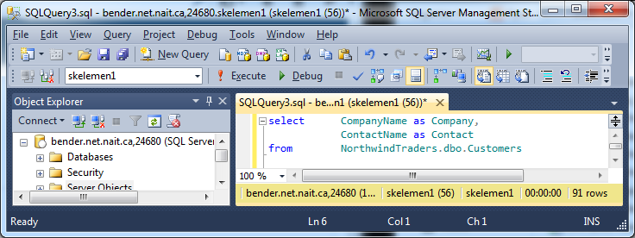
Aliasing Using as
This query returns…
Company Contact
---------------------------------------- -------------------------
Alfreds Futterkiste Maria Anders
Ana Trujillo Emparedados Ana Trujillo
Antonio Moreno Taquería Antonio Moreno

Slide 10

Aliasing in MS SQL Server
In SQL Server, you may also alias without the as keyword
  Caution should be used here, as this may not work properly in another RDBMS

Slide 11
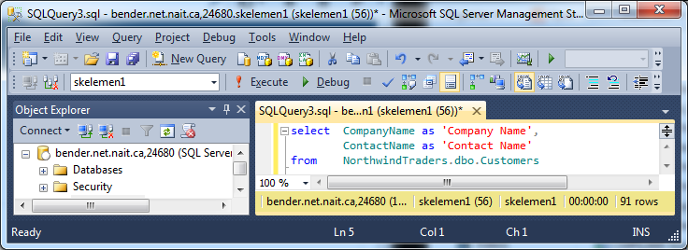
Aliasing
If you wish to include spaces in your result set column name, you may do so using single quotes

Slide 12
Why Alias?
An alias can be used to provide a different name for field names that contain spaces
  FName becomes ‘First Name’
Aliases may be used to make better sense of cryptic database column names
  au_n becomes ‘Author Name’
Aliasing can be used to name calculated fields that are not stored as table columns
  By default, calculations do not show up with column names in result sets
  (Cost * Units) becomes ‘Total Cost’ instead of (no column name)

Slide 13
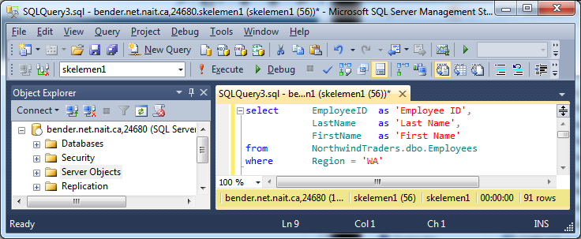
Filtering Data Using where
The where clause is used to specify the criteria for selecting records

Slide 14
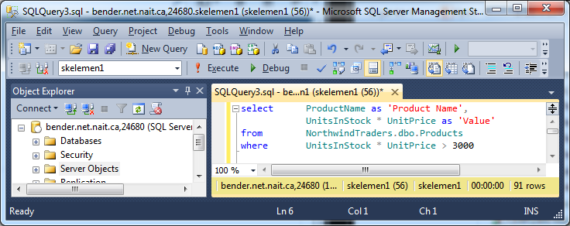
Calculated Values
Calculations can be made using the data fields within a select query.
  Note that if you also wish to use the calculation as a filter, you must repeat the calculation as shown below.

Slide 15
null Values
A null value is an unknown value
  null means we do not know what value should be in a field for a particular record.
  Be careful not to confuse null with an empty value. They are not the same thing, as has been demonstrated on the following slides.
    Note that their behavior differs even when being compared to themselves.

Slide 16
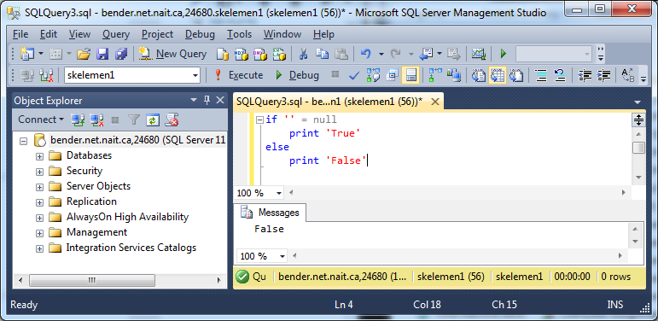
null Values

Slide 17
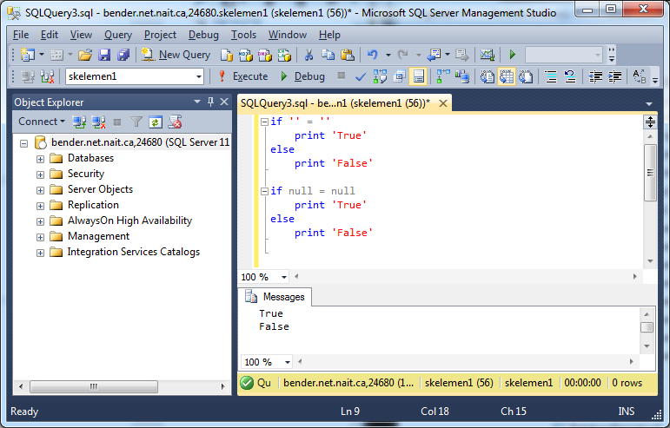
null Values

Slide 18
null Values
In order to compare nulls, you must use the is operator.
select CompanyName as Company
from NorthwindTraders.dbo.Customers
where Region is null
  This displays customers not in the US or in Canada, where the Region field is null

Slide 19
Stored Procedures
Stored procedures are pre-compiled code that is stored on, and runs inside, the database server thus making it more efficient than when passed from another application across a connection.
  A stored procedure may perform any task that a regular SQL statement may perform, as they are built using SQL.

Slide 20
Stored Procedures
Stored procedures may accept any number of parameters, either as literal values, or as variables passed from the caller.
Stored procedures may deliver data to the user in three ways:
  Via the return code
    This code is always an integer and is often used to indicate the status of execution within the stored procedure.
  Via results
  Via output parameters
    These parameters may be viewed in the same light as a ref modified parameter passed to a method in C#.

Slide 21
Stored Procedures
Just like functions, stored procedures may be called from within other stored procedures.
  They may also be grouped together to form libraries where the user may only be granted access to the top layer of procedures, which in turn may call other procedures during their execution.
As all execution happens on the database server, only data contained in the final result set, output parameters, and return code are passed back to the client or client application.
  This in no way limits the versatility of a stored procedure, or set of stored procedures, and different paths of execution may be created through proper use of branching.

Slide 22
Modularization
Stored procedures allow complex SQL coding to be broken up into logical units.
  Leads to more easily manageable SQL code
  Allows reusability if a stored procedure is created to perform a simple task rather than a series of tasks unique to a particular application

Slide 23
Security
Using stored procedures, we may create a user interface for client applications
  This allows us to fully restrict access to the structure and data within our database, except through strict controls laid out within our stored procedures.
  Consider an MMO game, be it RPG or first person shooter, which allows you to change the equipment your character owns or uses at any point in time.
    All updating, inserting, and deleting of records would be performed through stored procedures.
    This will allow for server-side data validation and access restriction, thus protecting our database integrity.

Slide 24
Object Existence
A stored procedure is seen as an object in the database, and as one might expect, you must not have two existing objects with the same name.
Thus, we need to determine whether the stored procedure already exists before we attempt a create statement. If it does exist, and we do not care to preserve the current procedure, we may drop it.
  Note that you may NOT drop or create procedures in databases other than the one you are currently using.
if exists
(
select [name]
from sysobjects
where [name] = ‘SP_ProcedureName’
)
drop procedure SP_ProcedureName
go

Slide 25
Beginning Syntax
To create a simple stored procedure, use the following
create proc[edure] SP_ProcedureName
as
SQL statement
go
In order to use the stored procedure we have created, the following line should be executed
exec[ute] SP_ProcedureName
go

Slide 26
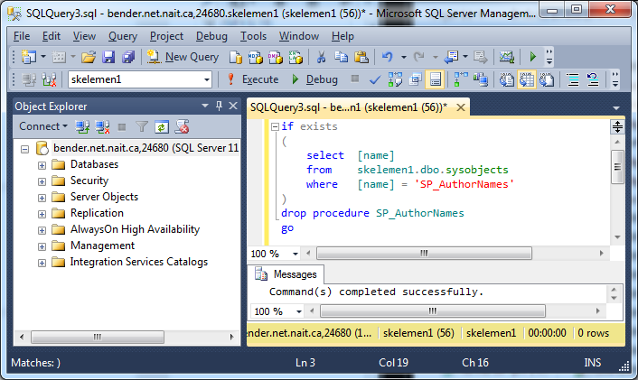
Basic Example
Get all of the authors first and last names formatted as ‘FirstName LastName’ from the authors table in the pubs database
First, make sure the procedure does not exist

Slide 27
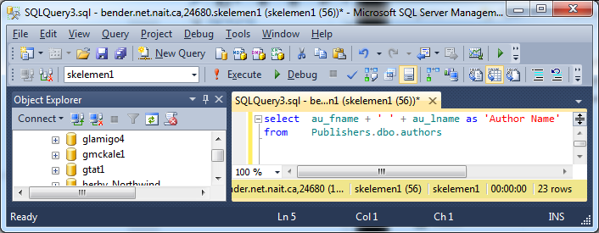
Basic Example
Second, build the regular SQL statement to accomplish the task, and test it to see the expected results.

Slide 28
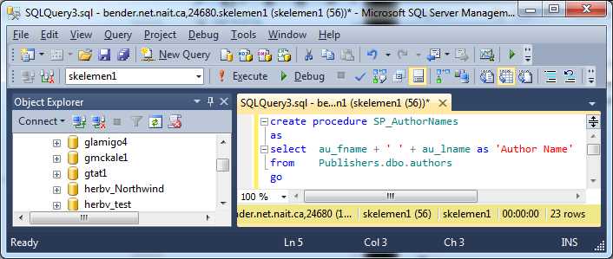
Basic Example
Third, embed the SQL in a procedure creation batch.

Slide 29
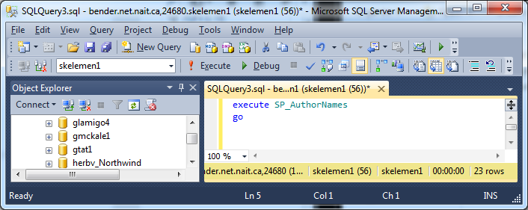
Basic Example
Finally, we may execute the procedure and compare the results to what we saw previously.

Slide 30
Basic Example Results
Author Name
-------------------------------------------------------------
Abraham Bennet
Reginald Blotchet-Halls
Cheryl Carson
Michel DeFrance
Innes del Castillo
Ann Dull
Marjorie Green
Morningstar Greene
Burt Gringlesby
Sheryl Hunter
Livia Karsen
Charlene Locksley
Stearns MacFeather
Heather McBadden
Michael O'Leary
Sylvia Panteley
Albert Ringer
Anne Ringer
Meander Smith
Dean Straight
Dirk Stringer
Johnson White
Akiko Yokomoto
(23 row(s) affected)

